Slide 1

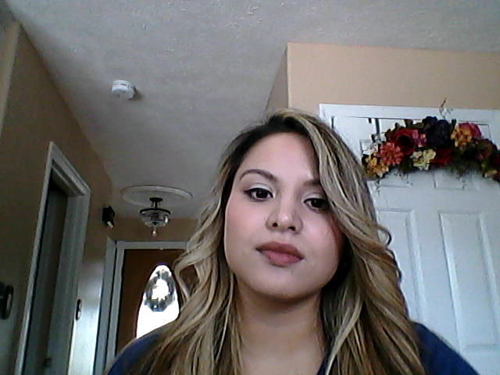
May 1915 Charlotte Mew
By: Zuly Cabrera Aldana

